Slide 1

Compiler Design

Slide 2
Compiler Design

Slide 3
Compiler Design

Slide 4
Compiler Design

Slide 5
Compiler Design

Slide 6
Compiler Design

Slide 7
Compiler Design

Slide 8
Compiler Design

Slide 9
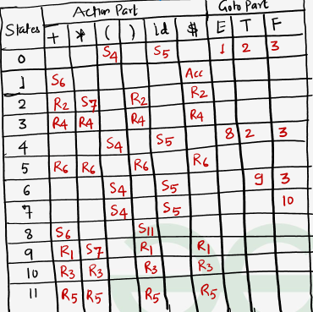
Compiler Design

Slide 10
Compiler Design

Slide 11
Compiler Design

Slide 12
Compiler Design

Slide 13
Compiler Design

Slide 14
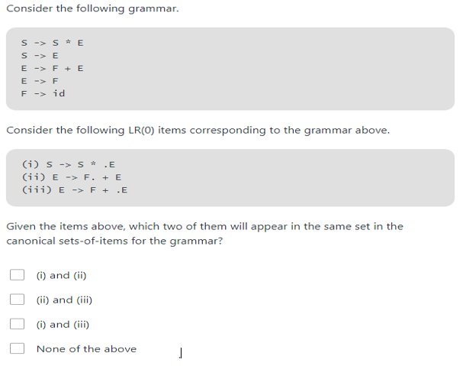
Compiler Design

Slide 15
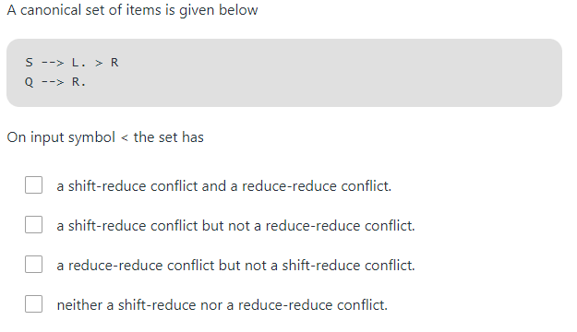
Compiler Design

Slide 16
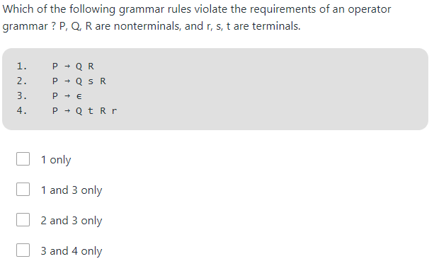
Compiler Design

Slide 17
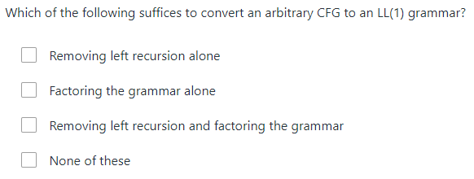
Compiler Design

Slide 18
Thank You !

